Slide 1
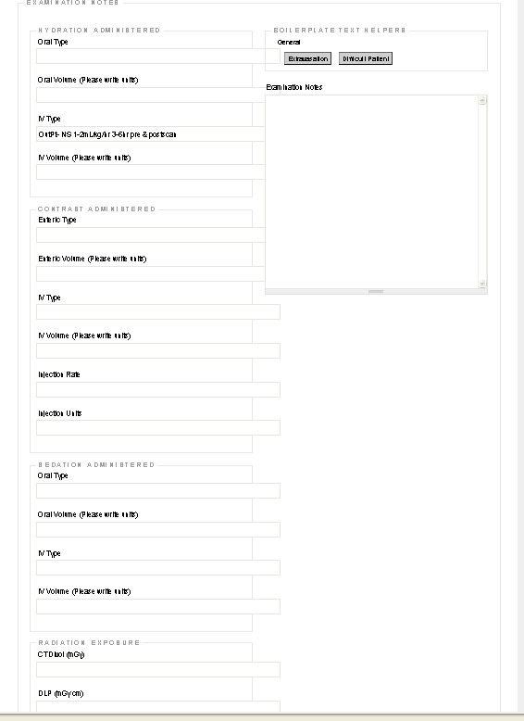

Slide 2
Technologist Page: by TimD
CONTRAST should be 1st and hydration protocols are rare. These hydration annotations should be administered by Nurse or MD(if IV). Hydration protocols should be noted in the Radiologists notes and possibly in the Nurse notes.
Name of oral contrast:
Amount of oral contrast:
Name of IV contrast:
Amount of IV contrast:
Injection rate:
IV site:
IV gage size
IV Complications:
Exam Notes:
Technologists do not administer sedation so the sedation information should be on another page and not on the Technologist page

